Slide 1
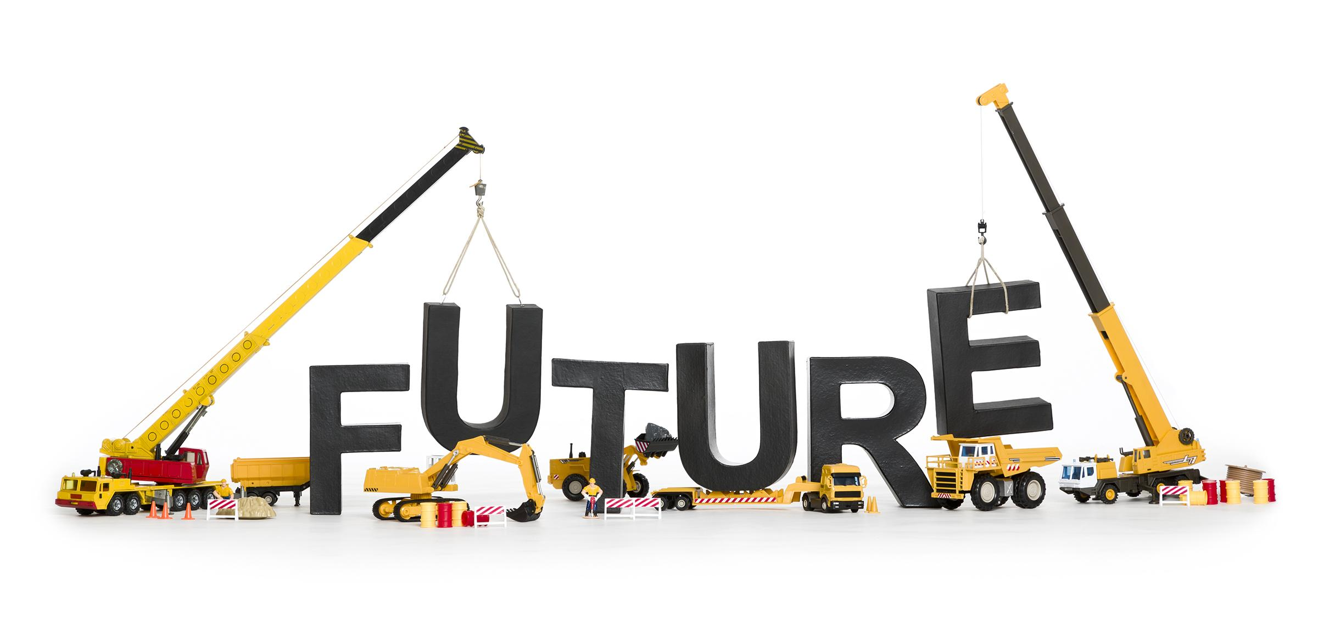
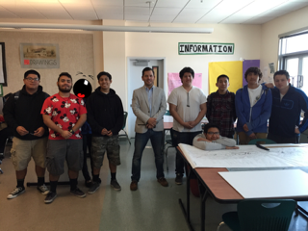
Hollywood Central Park
BTF Consultants
“Building the Future”

Slide 2
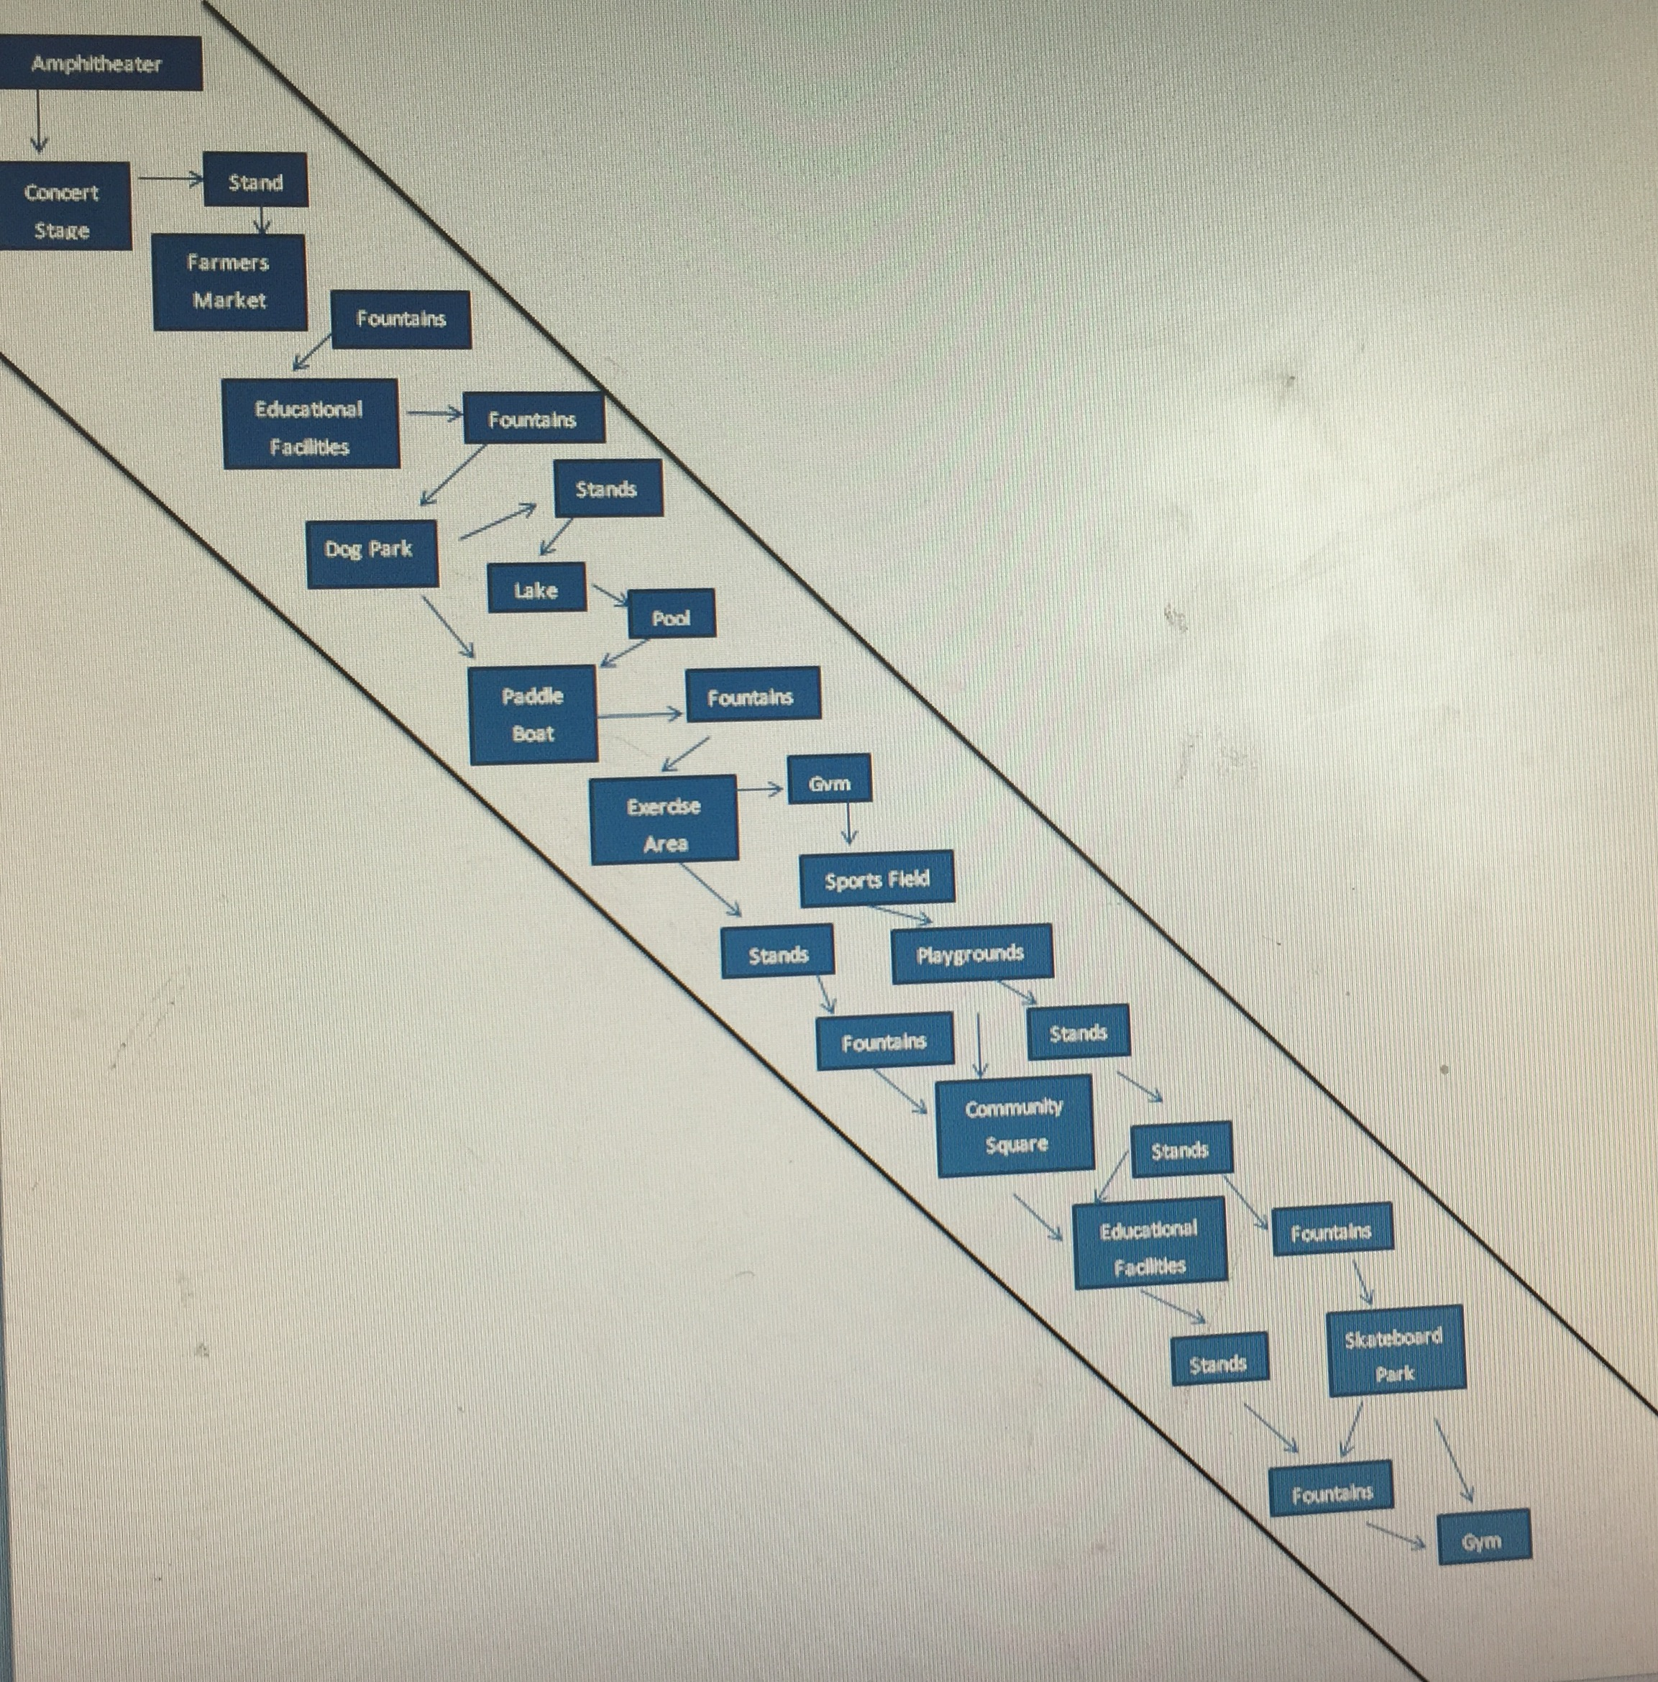
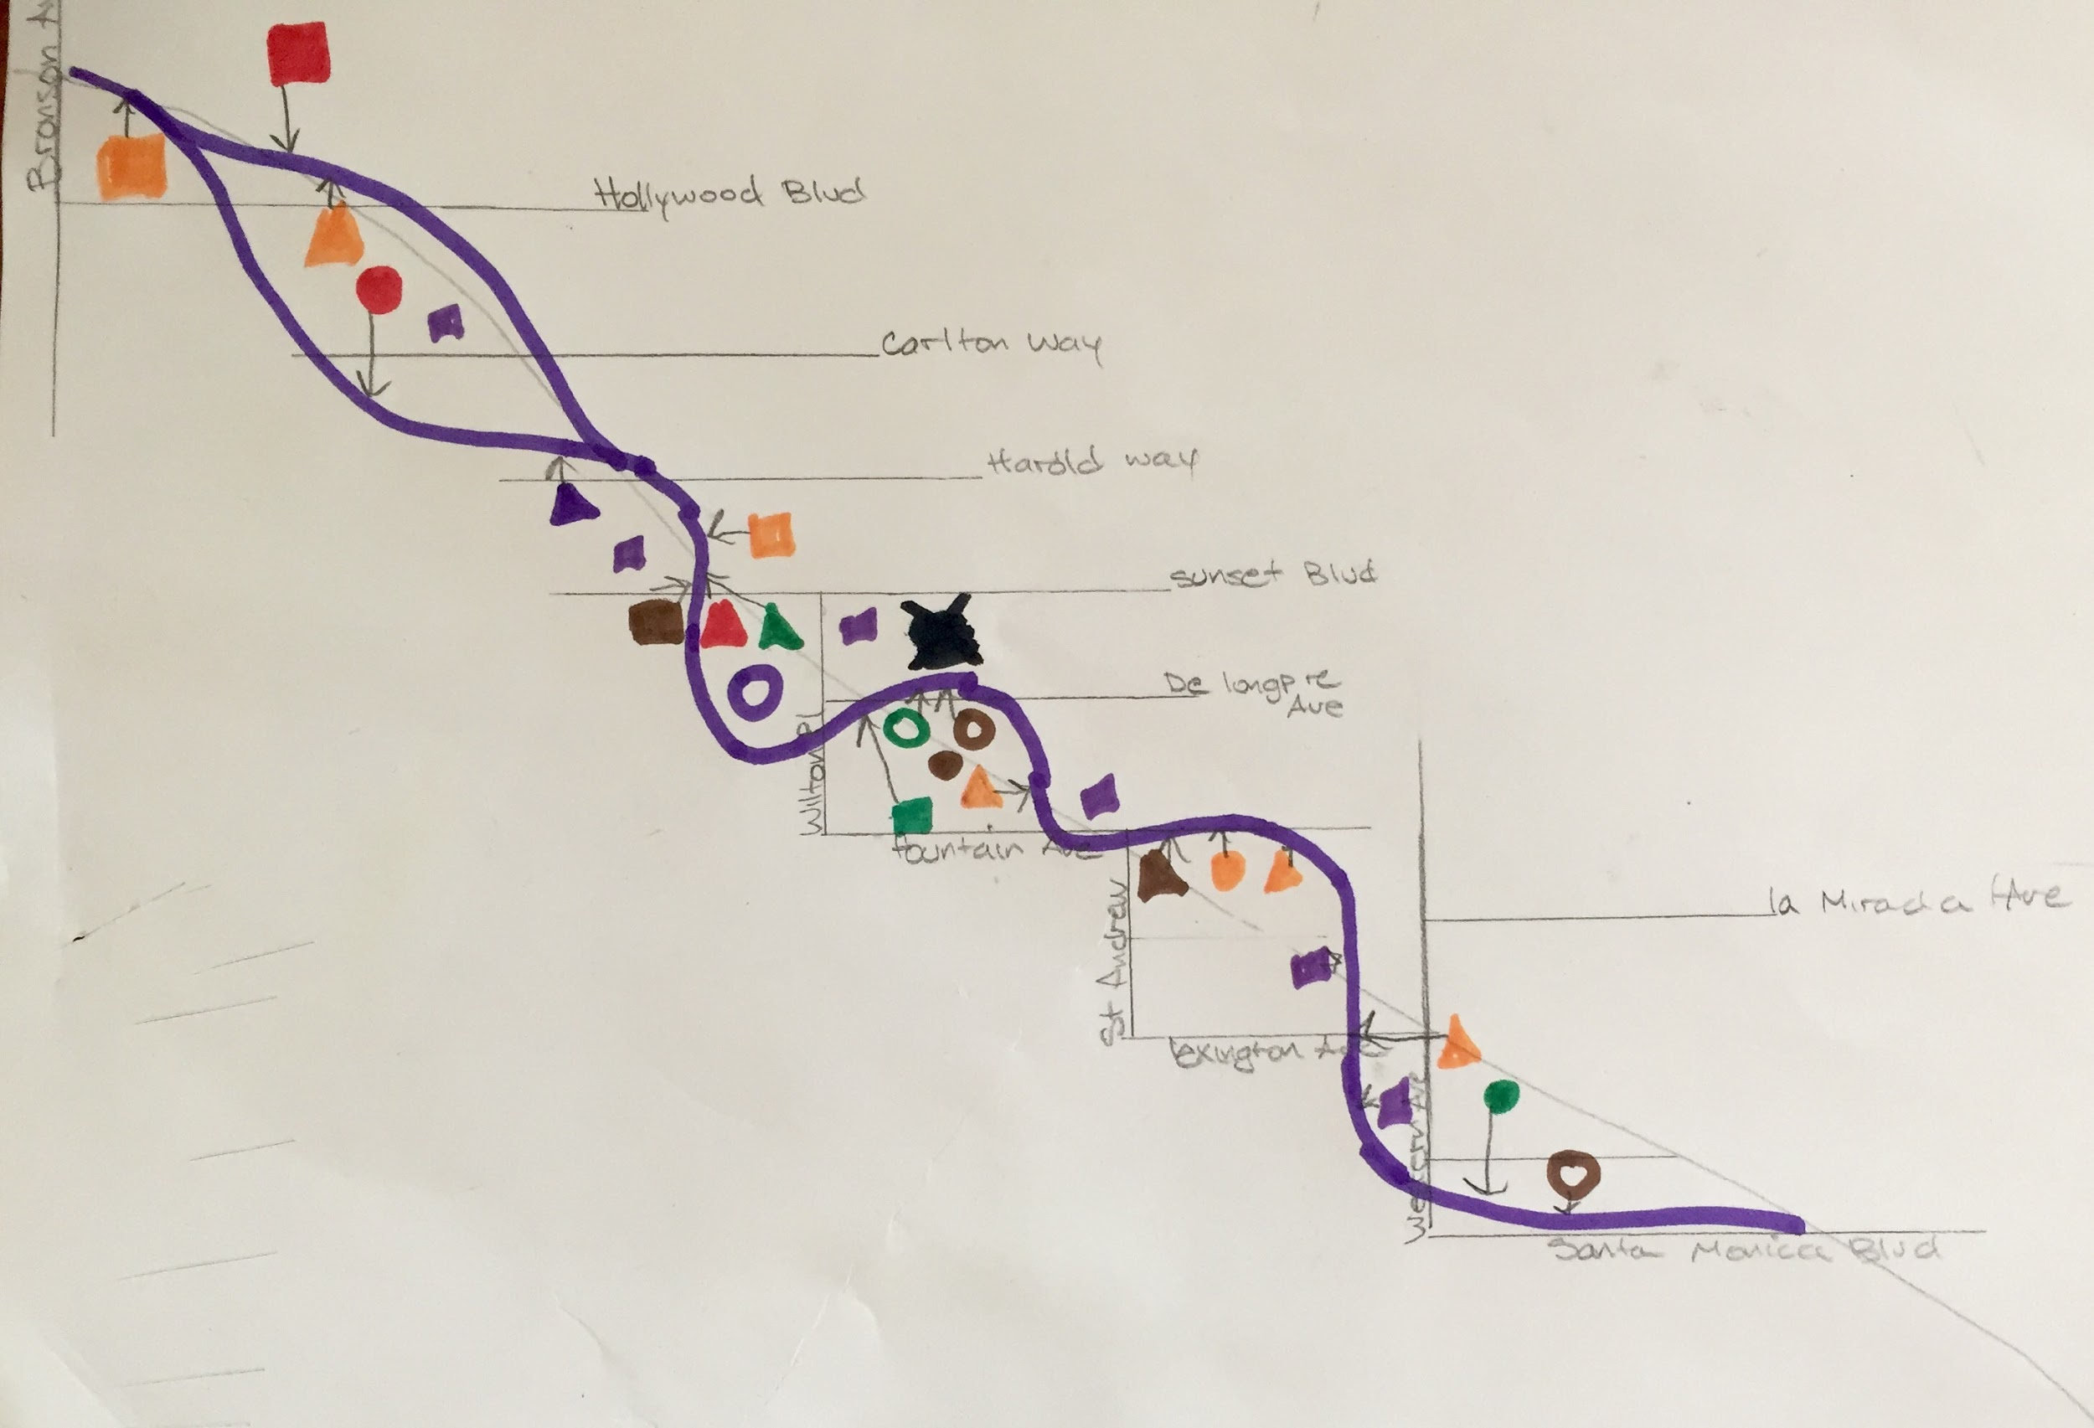
Programming Diagrams

Slide 3
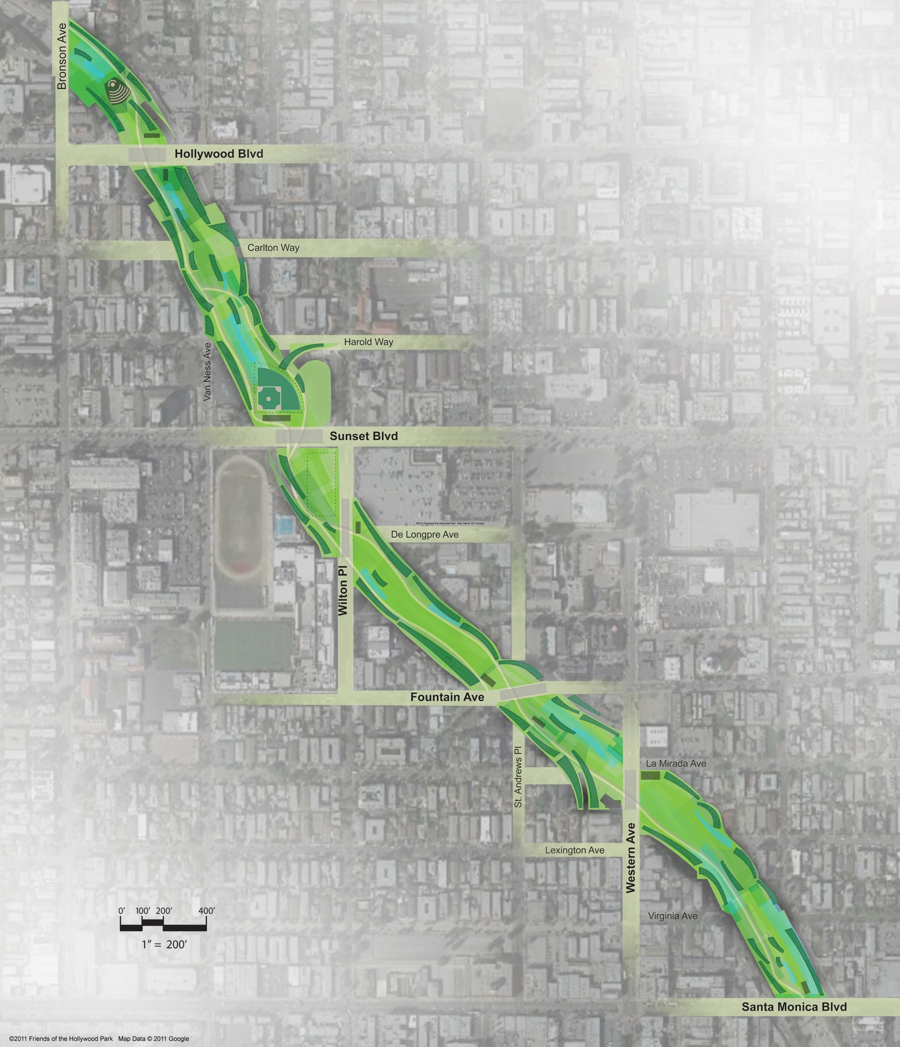
Project Advantages
Project Challenges
Generates money for economy
Job Opportunities
Gives neighborhood a space to build a deeper sense of community
Consists of several entertainment options for community
Promotes healthy outdoor living
Safe green space for community
Environmentally friendly
Aesthetically pleasing
Challenge to construct
Can be dangerous (weather/earthquake) if not built precisely and perfectly
Traffic issues (especially if streets are closed during the construction)

Slide 4
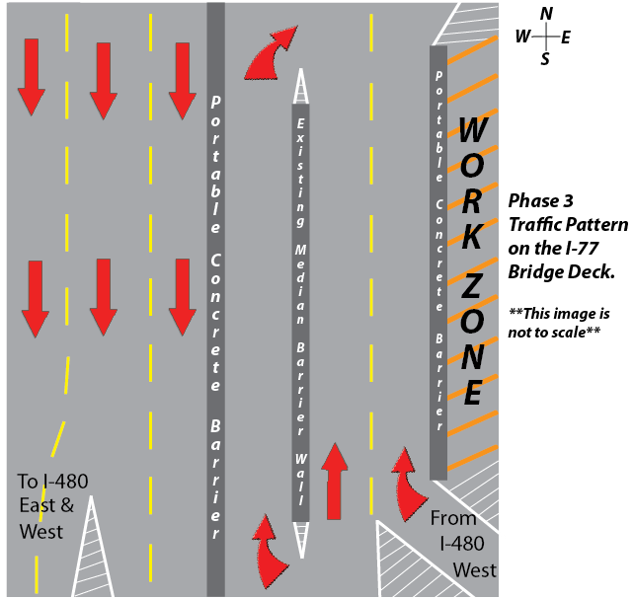
Transportation Design
101 freeway consists of heavy traffic flow daily
Main issue of traffic will be during construction of park structure and the pedestrian foot bridges over the major streets that cross the park
Construction Phases
Engineers and construction teams should ensure the phases of construction are properly planned to create the least traffic disturbance. For example-Building at night (off-peak traffic hours) and weekends, reconfigure lanes for smooth transitions, pavement marking, and appropriate signage.

Slide 5
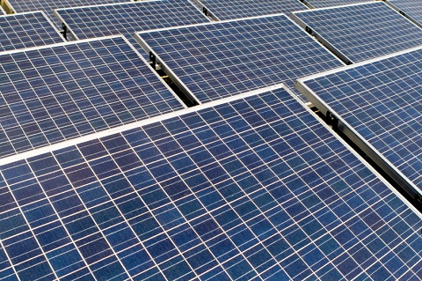
Using Green Technology
Solar Panels

Slide 6
Photovoltaic
What is Photovoltaic?
A method of converting solar energy into direct current electricity using semiconducting materials
Why is Hollywood the perfect location to use solar energy?
-Amount of annual sunlight
-Not as dusty as the desert areas(red on map) (less dirt collection on solar panels)
-Low precipitation

Slide 7
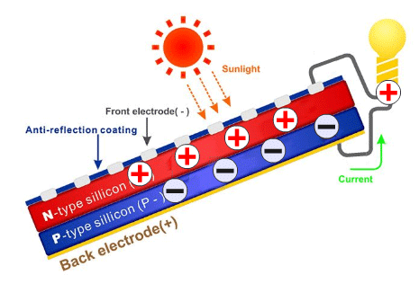
How exactly do Solar Panels work?
Sunlight consists of photons and they hit the solar panel
Solar panels contain photovoltaic cells made of 2 layers of silicon material, the first layer has an excessive amount of electrons already and the second not as many
As the sunlight energy passes through the first layer the energy knocks the electrons to move around
The excess electrons move to the second layer and the overflow then creates a current of electricity

Slide 8
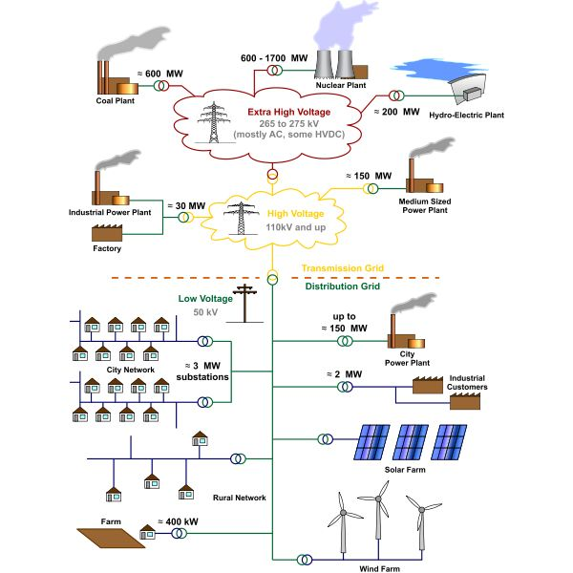
How do Solar Panels work in an electric system?
The Grid-The electric system that a city/county runs on. The wires both above and below ground that transfer electricity from power plant to residences or commercial buildings.
All buildings/structures that require electricity are typically connected to the grid.
If they run off of a generator or alternative source of electricity they are considered “off-grid”
The solar panels we plan to use will still be connected to the grid

Slide 9
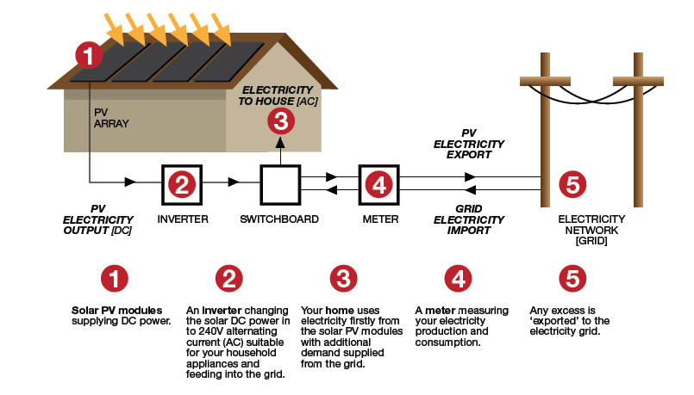
How do Solar Panels work in an electric system?
Solar Panel obtains energy from the sunlight
An inverter changes sunlight energy (DC electricity) into to usable electricity (AC electricity)
Building meter records amount of converted energy
The electric switchboard then distributes the electricity to the building outlets (powers everything)
Excess energy is exported to the city grid (giving the customer positive credit/money for electricity) or is stored in an external battery for emergency use.

Slide 10
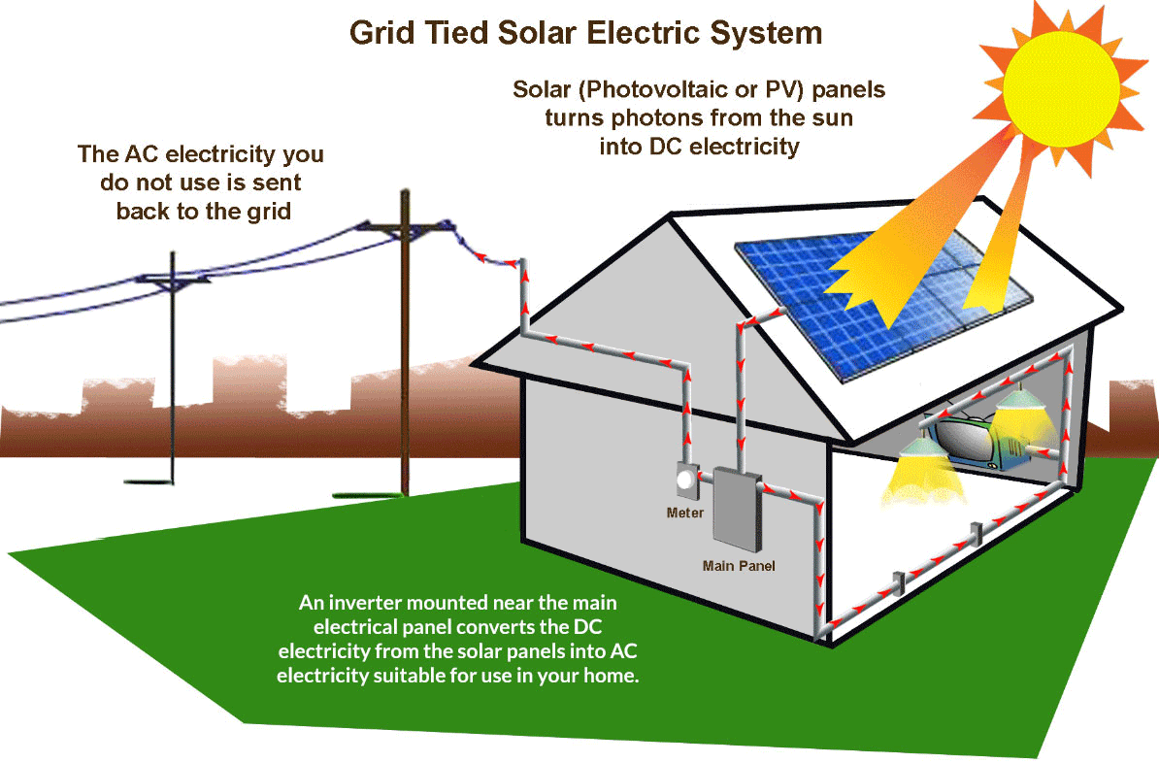
How exactly do Solar Panels work?

Slide 11
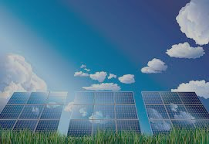
Our Solar Paneled Park Design!
Planning
Benefits
Solar Orientation and Design
2-3 days to install
Some companies like Solar City offer free installation
Wire to structure
Environmentally friendly-emission free while generating energy
Saves money
Uses natural resources for energy
Sunlight consistent in this location
Can make money

