Slide 1
Hollywood Central Park
XYZ Consultants: Buyan Batbaatar, Harrison Balmonte, Raphael Calalo, Charles Kwak, Terrance Mack, Yaricsa Picon, & Kristen Quinones

Slide 2
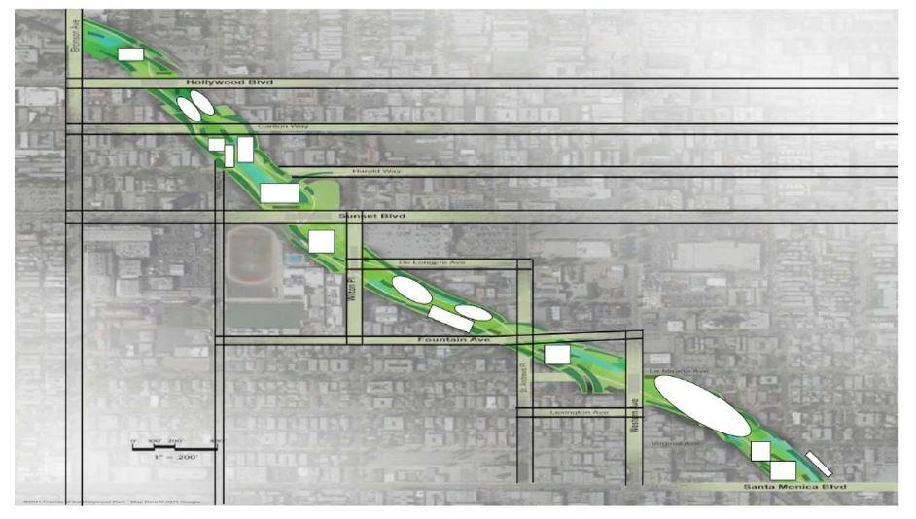
Programming Diagram
1
Buildings:
Amphitheatre
Restaurant
Playground
Bike shop
Skate park
Community Center
Art Gallery
Restaurant
Farmer’s Market
Bike Shop
2
3
4
5
6
7
8
9
10

Slide 3
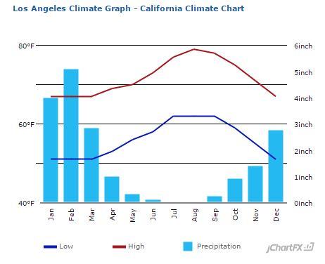
Site Analysis
Important because:
1) Know current conditions 2) Identify potential impacts
3) Discover hazards
Water runoff
Post-Development (considering a 24 hour storm within 50 years)
Total Land: 44 acres
Bikeshop- 0.332cfs
Farmers Market- 0.402 cfs
Dog Park- 0.055 cfs
Restaurant- 0.560 cfs
Bed and Breakfast- 1.145 cfs
Community Center- 2.107 cfs
Skatepark- 2.011 cfs
Playground- 0.103 cfs
Amphitheatre- 31.416 cfs
Grass- 61.714 cfs
Total Pre-Development water runoff: 100.448 cfs
Plan to build during months with the least rain-prevent water runoff issues
Pre-Development
Total park area: 38 acres
Q=332.264 cfs
Total Pre-Development water runoff: 332.264 cfs
Pre and Post Development Difference
231.816 cfs

Slide 4
Seismic Hazards
Hollywood Fault Line: 1/2 mile away
Elysian Park Fault Line: 1 mile away
Ensure that the structural design follows California standards and can withstand the required earthquake of 7.0 or greater magnitude.
-California Building Code

Slide 5
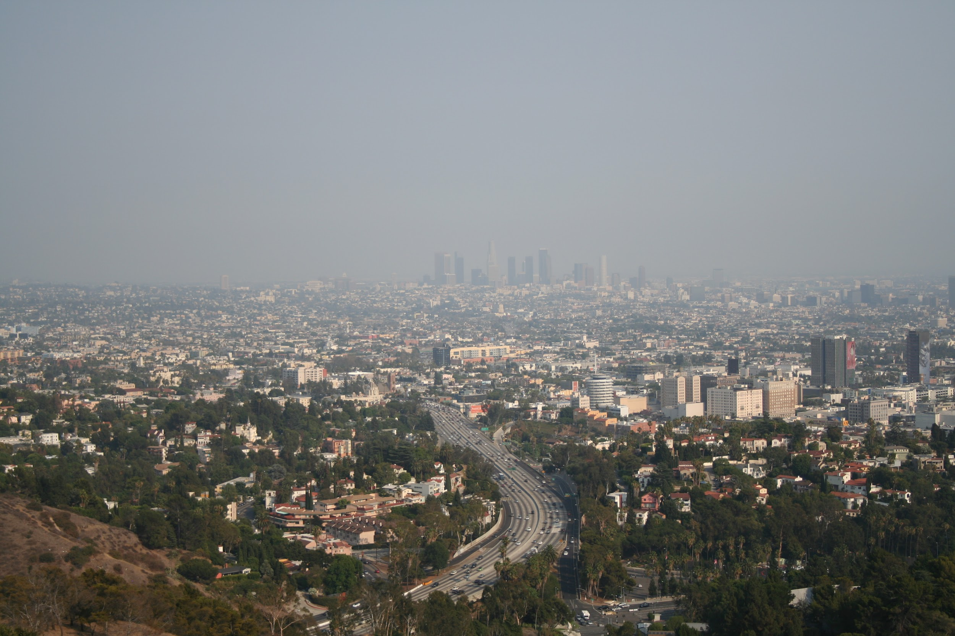
Air Quality
4th highest year round particle pollution.
Highest ozone (smog) pollution in the United States.Smog
harms respiratory system
decreases life expectancy

Slide 6
Using Green Technology
ESPs
Electrostatic Precipitators

Slide 7
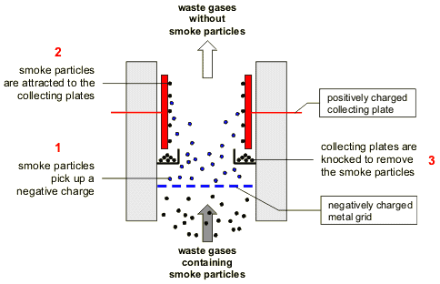
Prevent Air Pollution
Electrostatic Precipitators
An air filtration system that removes toxic particles from flowing gas and turns it into clean air
Air enters this device and flows through a negatively charged plate. The toxic particles are negatively charged and then the air flows through another chamber that contains positive plate. These positive plates attract the negatively charged particles and they collect on these plates. The clean air is then discharged out the other end.

Slide 8
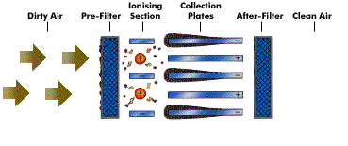
Process

Slide 9
Pros & Cons
Pros
High collection efficiency
Normal maintenance
Can be operated around 300-450℃
Few moving parts
Cons
Expensive
Requires high voltage
Needs a lot of space
Collection efficiency is reduced by the time

Slide 10
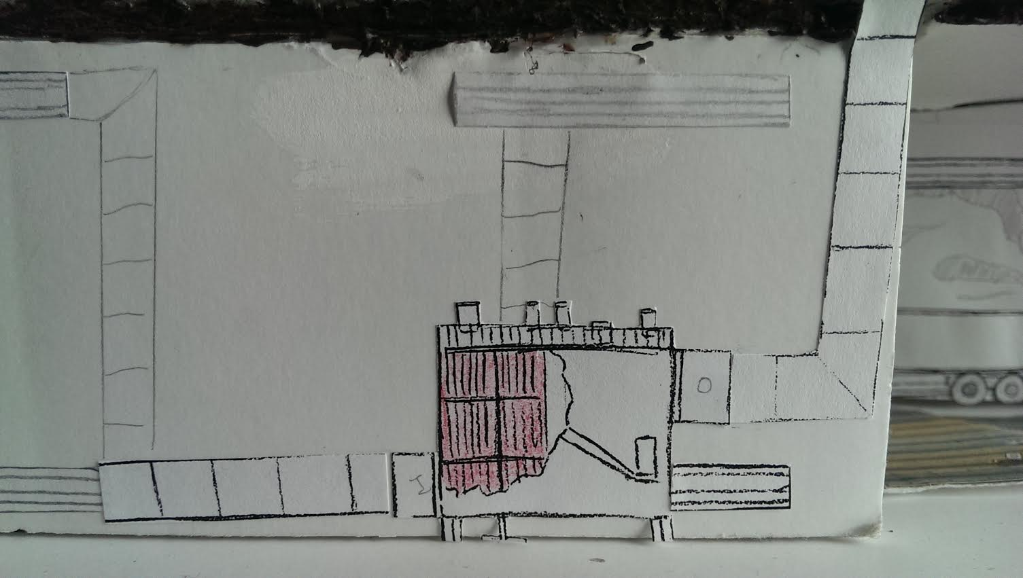
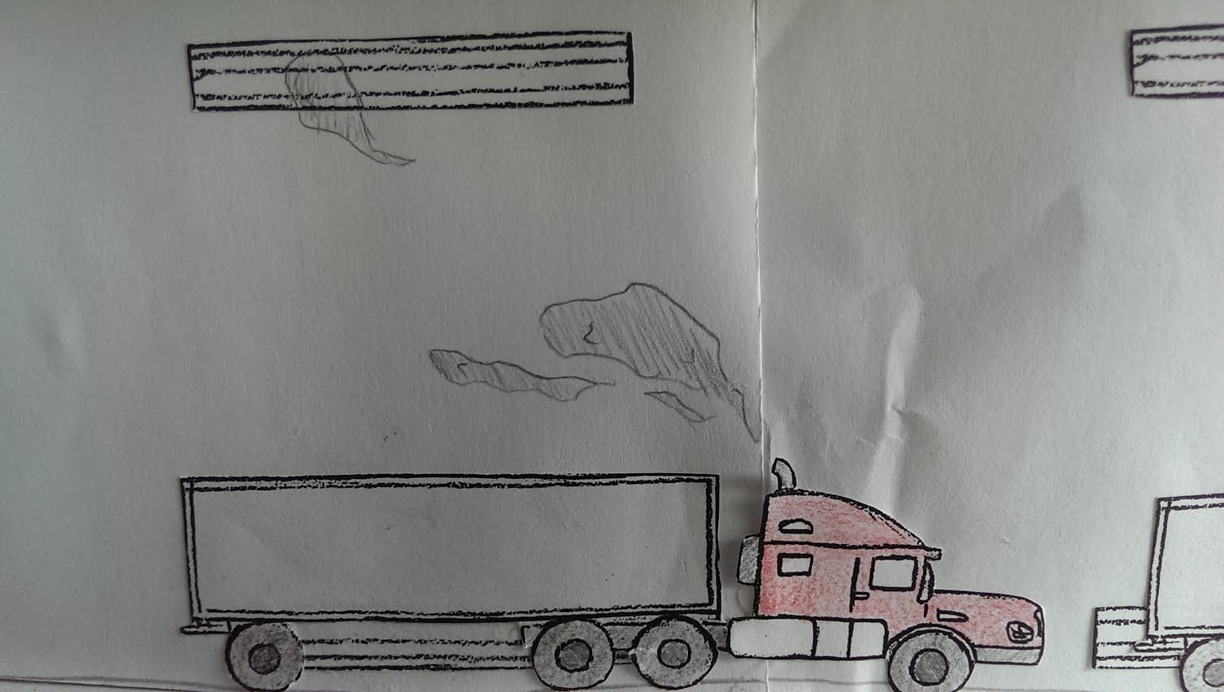
Electrostatic Precipitators
How we plan to incorporate these into the park?
Along the roadway structure walls and released above ground in the park
New Technology-Include a cooling fan at output vents to cool the air
Waste gases from vehicles going into ventilation shafts
Placed underground behind freeway walls

Slide 11
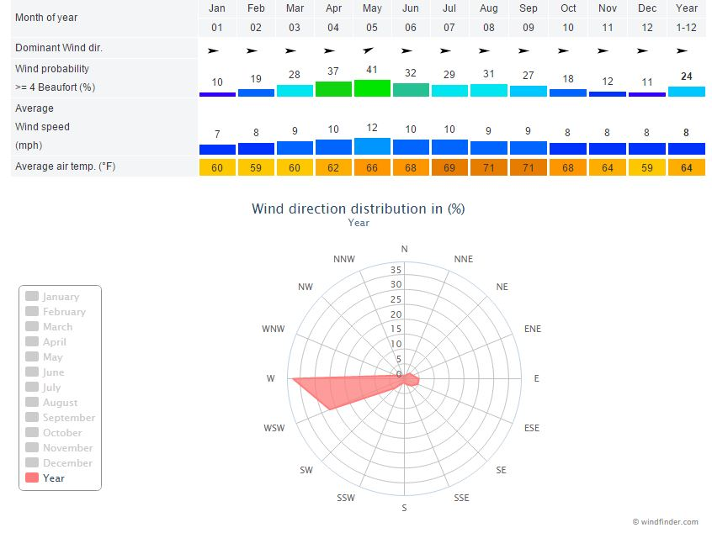
Cooling Microclimate
-Analyze wind directions to place structures(buildings and landscape) to ensure the optimal wind flow.
-Add fan to top of ESP output vent to cool air coming from freeway into the park

Slide 12
Park Design Benefits
Beautiful green space for the community to enjoy
Urban park cooling microclimate
Position of buildings and trees based on wind analysis
Vents from Electrostatic Precipitators can go through fans to create cool air flow throughout the park
Cleaner air
Plants and grass will reduce stormwater runoff

